Slide 1
Act 1. Scene 1

Slide 2

两个老头密谋打赌的场景 找不到合适的☹

Slide 4
Act 1. Scene 2

Slide 5
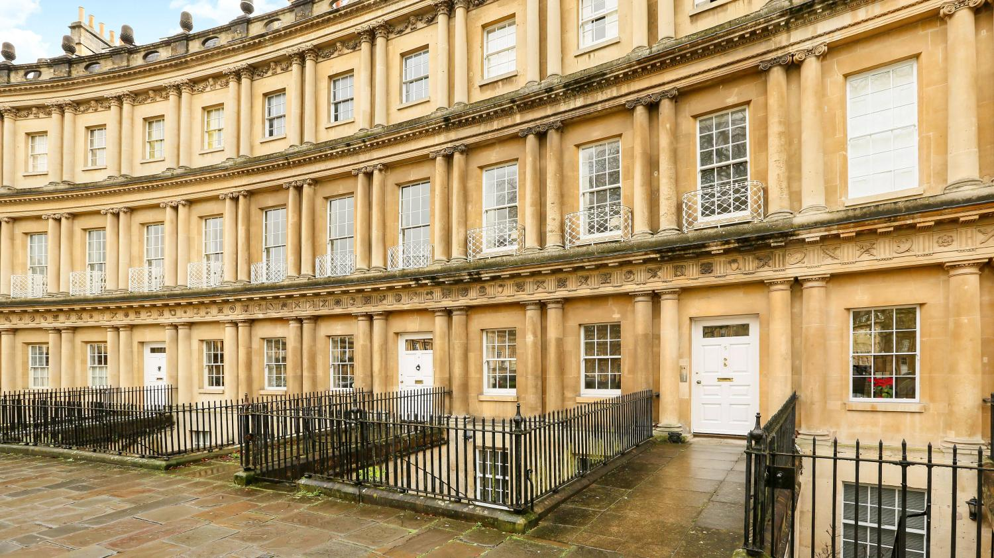

Slide 6


The enclosed Bank Note is lent to you for one month. If you return it intact at the end of that time, you shall have any job that is within our power to give you. It may interest you to know that we have a bet on you.
两个老头密谋打赌的场景 找不到合适的☹

Slide 8
Act 2

Slide 9


Slide 10
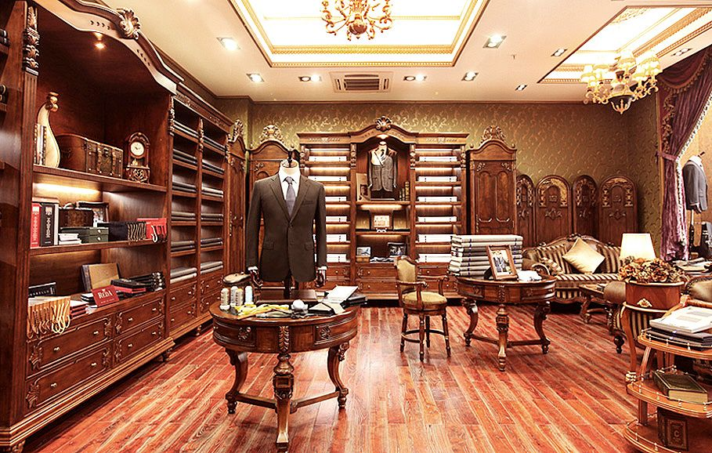

Slide 12
Act 3

Slide 13


Slide 15
Act 4

Slide 16


Slide 18
Act 5. Scene 1

Slide 19


Slide 20


Slide 22
Act 5. Scene 2

Slide 23


Slide 25
Act 5. Scene 3

Slide 26
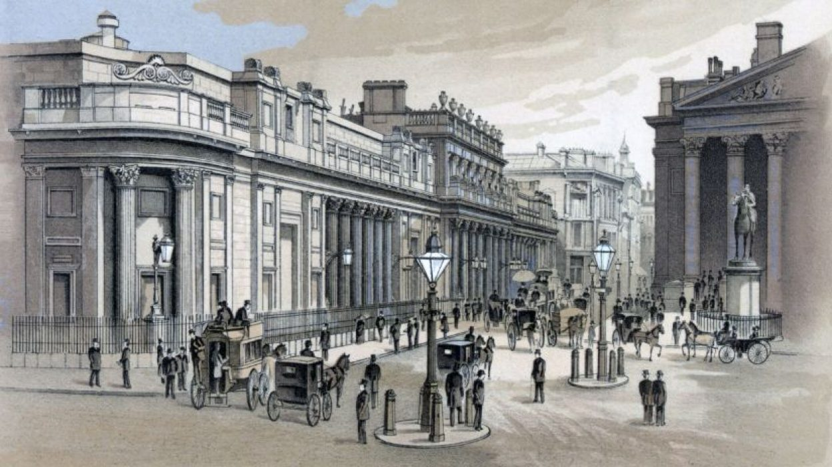
London Stock Exchange

Slide 28
Act 6

Slide 29
两个老头密谋打赌的场景 找不到合适的☹

